Slide 1
Data Visualization: ggplot2

Slide 2


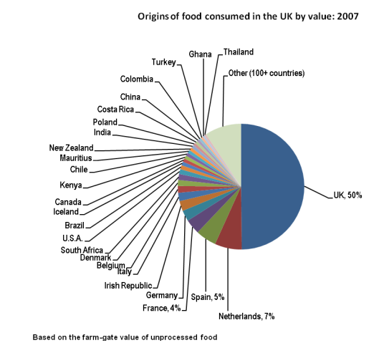

First up: recognizing bad graphs
z
z

Slide 3
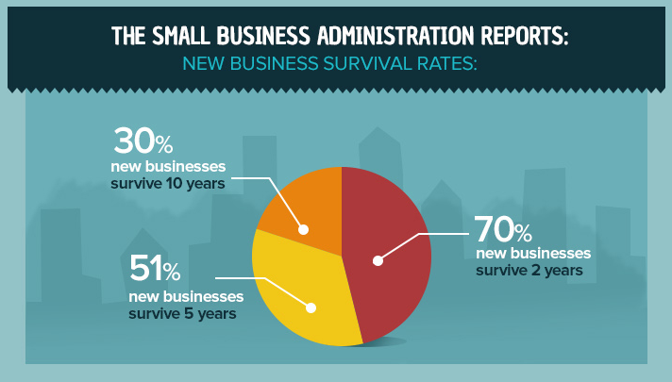
Pie charts really can go wrong a lot

Slide 4
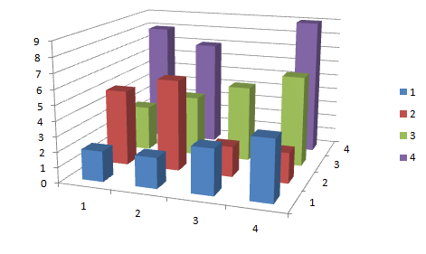
????
z

Slide 5
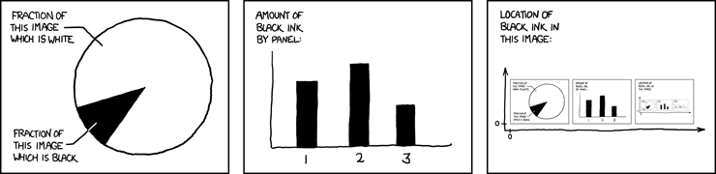
Relevant xkcd
z
z

Slide 6

A few key points on design
Know what point you want to tell, and strip away everything else
Be careful about associations or assumptions the audience might have
A little bit of context goes a very long way

Slide 7
Visualizing for different scenarios
EDA
Deliverables
For your own consumption
Rough, quick, variable inspection
Scatterplots and histograms
Base R functions usually work fine
For outside people who may not understand your data
Should tell one specific story or emphasize a single point
Simple is not a bad thing
ggplot: for more than line plots and pie charts!

Slide 8
The ggplot structure
ggplot
+ Data (as a DataFrame)
+ Aesthetic Mapping
+ Geometry
+ Options

Slide 9
Aesthetics (aes)
Function aes should include arguments for the specific variables you want to plot, or generally for the information you’re trying to visually encode
Examples:
aes(x = year, y = GDP)
aes(x = count)
aes(x = weight, y = mpg)

Slide 10
Geometry (geoms)
There are many different “geoms” that represent different types of shapes or visual elements actually used to show information.
Some are suitable for plotting only one variable, some for two or more.
Geom examples:
geom_histogram
geom_point
geom_boxplot

Slide 11
Aesthetics (aes)
Important side note!
aes can be passed to either the ggplot itself or to individual geoms
Example: ggplot(data, aes(x = year)) + geom_histogram()
is the same as
ggplot(data) + geom_histogram(aes(x = year))

Slide 12
Aesthetics for multiple dimensions
In general, your first two dimensions for aesthetic mapping should be x and y, like a scatterplot, bar plot, or line plot
If you have extra information you want to encode after that, such as categories, you can use aes for things like text labels, color, size, or shape

Slide 13
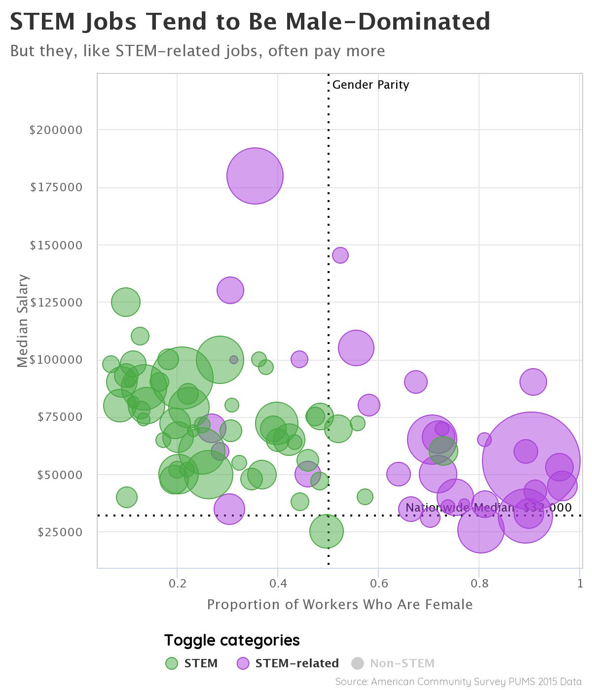
Example
z
z

Slide 14
Options
Titles
Axis labels
Themes
Legends
even shapes and text can be added item by item to a ggplot object

Slide 15
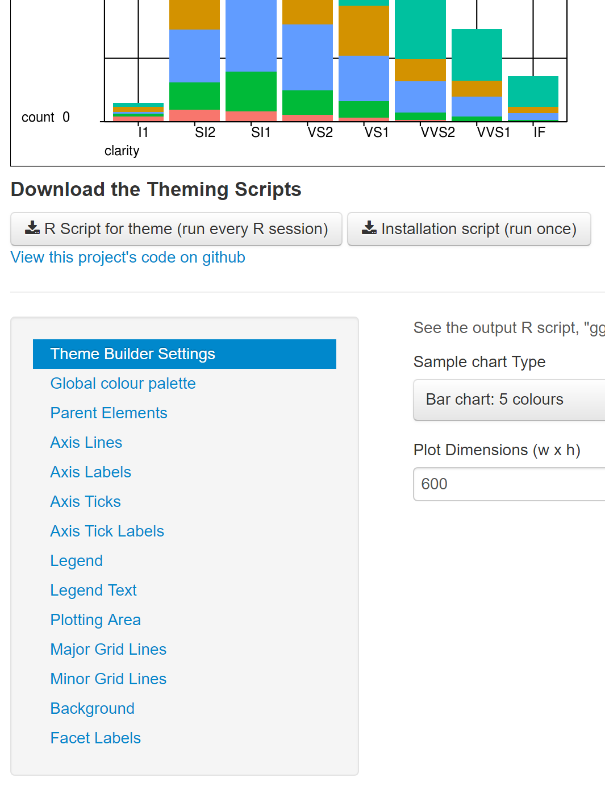
Cool thing: ggplot theme builder
z

Slide 16
ggplot cheat sheet
z

Slide 17
Coding Time!
z

